Slide 1
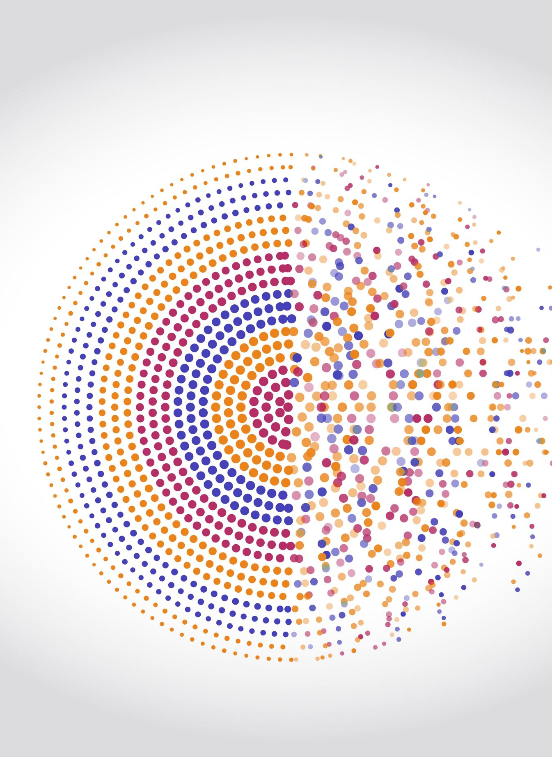
Movie Recommendation System
By
Priyanka S

Slide 2
Index
What is Recommendation System
Content Based Filtering & Collaborative Filtering
Use case: Movie Recommendation System
Implementation
Input
Model Building
Output
Conclusion

Slide 3

Recommendation system
A recommender system is a subclass of information filtering system that seeks to predict the "rating" or "preference" a user would give to an item.
There are many different things that can be recommended by the system like movies, books, news, articles, jobs, advertisements, etc. Netflix uses a recommender system to recommend movies & web-series to its users.
Two types of recommendation system -
Content based filtering
Collaborative filtering

Slide 4
Content based Recommendation System
A content-based recommender works with data that the user provides, either explicitly (rating) or implicitly (clicking on a link). Based on that data, a user profile is generated, which is then used to make suggestions to the user.
The concepts of Term Frequency (TF) and Inverse Document Frequency (IDF) are used in information retrieval systems also content-based filtering mechanisms. They are used to determine the relative importance of a document / article / news item / movie etc.
Example: Netflix, Flipkart, Myntra

Slide 5
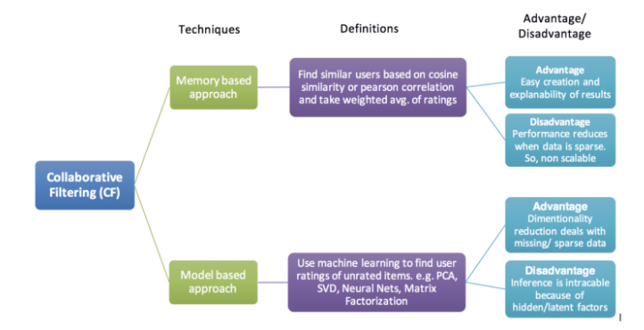
Collaborative based Recommendation System
Collaborative filtering models are based on assumption that people like things similar to other things they like, and things that are liked by other people with similar taste.
Types of collaborative filtering,
Memory based
Model based
Example: Amazon, Facebook

Slide 6
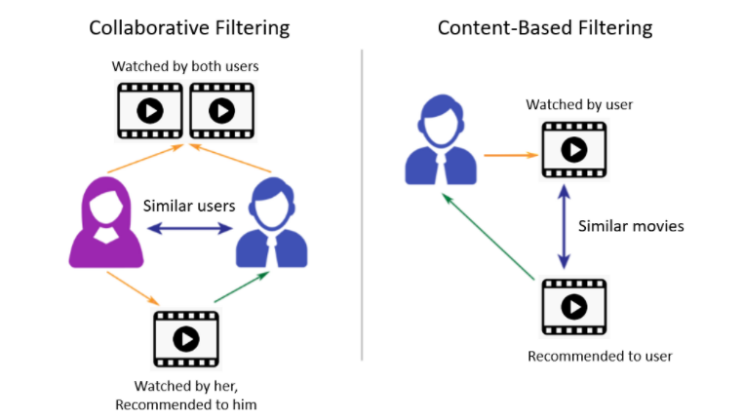
Collaborative Vs Content based Filtering

Slide 7
Movie Recommendation System
Problem Statement: Recommendation of movies appropriate movies to user
Objective: Suggest similar movies to user according to their likes.
Recommendation Technique : Content Filtering
Programming Language: Python,
For website UI: streamlit
Deployment Environment: Heroku
Model files: 1 . recommend.py
2 . app.py

Slide 8
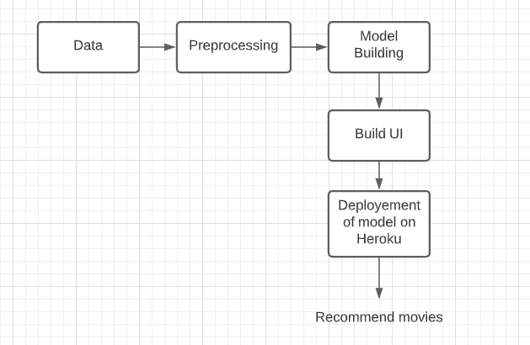
Movie Recommendation System : Implementation

Slide 9
Movie Recommendation System : Input
Data source: https://www.kaggle.com/tmdb/tmdb-movie-metadata?select=tmdb_5000_movies.csv
Data files: 1. tmdb_5000_credits.csv
2. tmdb_5000_movies.csv
tmdb_5000_credits.csv : It consist information about movie title, cast, crew.
tmdb_5000_movies.csv : It consist information about movie budget , genres , popularity, production_companies, release_date, revenue, title etc.

Slide 10
Movie Recommendation System : Data Preprocessing
Data merging from both dataset on movie ID
Feature selection (just put appropriate columns for model building)
Data cleaning / Text cleaning
Creating tag from selected columns
Created final dataframe with ID, Title and Tags
Convert text into vectors and for that we can use Bag of Words.
Apply steaming of word corpus

Slide 11
Movie Recommendation System : Model
Once word corpus is ready we will build recommendation model.
Distance and similarity are inversely proportional.
Cosine distance : instead of calculating distance we will calculate angle between two points.
Using cosine similarity capture top 5 similar movies based on similarity value.

Slide 12
Movie Recommendation System : UI
Package used: streamlit
streamlit is an open-source Python library that makes it easy to create and share beautiful, custom web apps for machine learning and data science.
To used recommendation model in UI pickle your model in .pkl file.
Created a UI to show recommendation model where we can take input from user and show them appropriate movies as result.

Slide 13
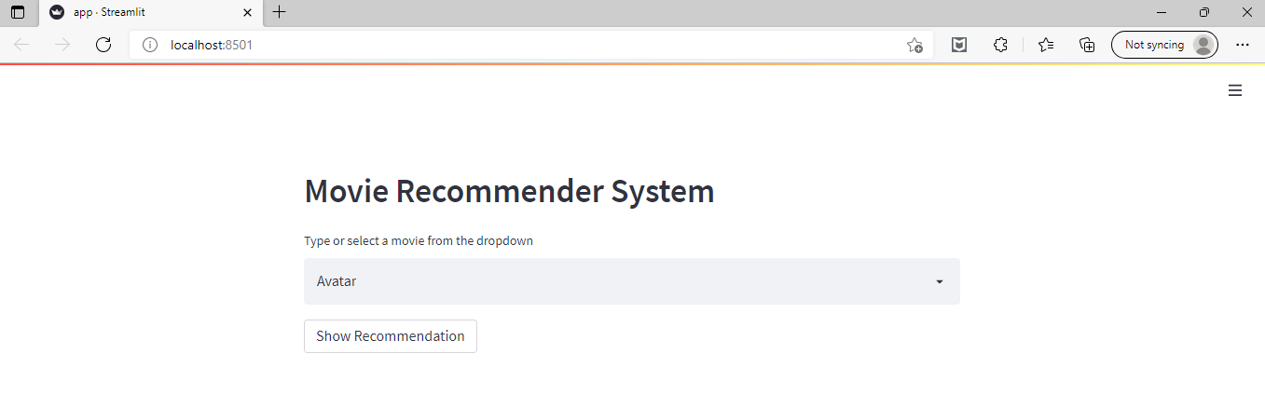
Movie Recommendation System : Output

Slide 14
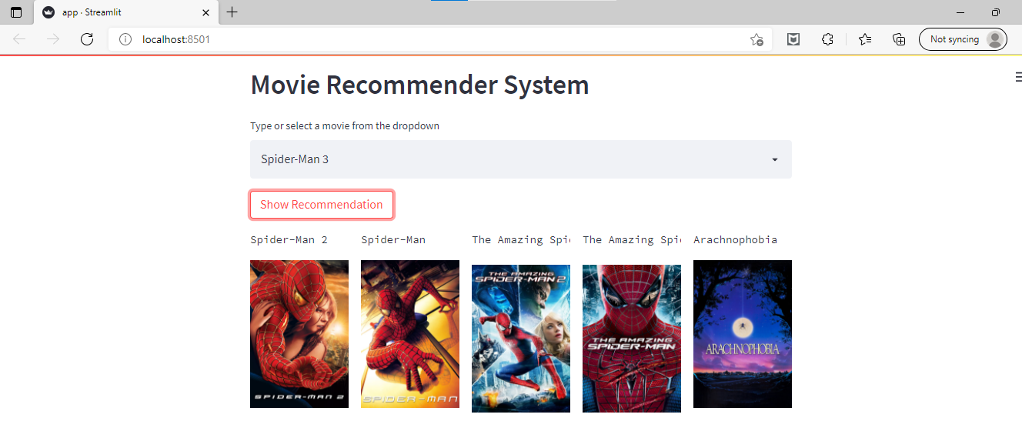
Movie Recommendation System : Output

Slide 15
Movie Recommendation System : Conclusion
By using content based filtering we can recommend movies to user based on similarity of movies.

Slide 16
Thank you

